Slide 2
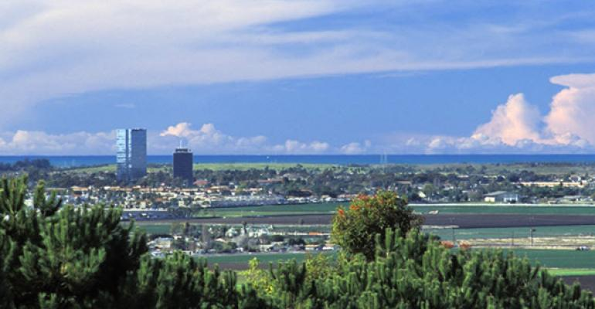
2020 Census in Ventura County
2020 Census in Ventura County
WHAT’S AT STAKE:
Every person not counted is a loss of $2,000 in social safety services every year for 10 years.
This means, if 1,000 children between the ages of 1 – 5 are not counted in Simi Valley, that’s a loss of $20M over the next 10 years.

Slide 3
TODAY’S AGENDA
Overview of the Decennial Census
Monetary Impact
Barriers to an Accurate Count
Complete Count Committee in Ventura County
Your Involvement and Why it is Vital
Timeline
Strategic Discussion
Next Steps

Slide 4
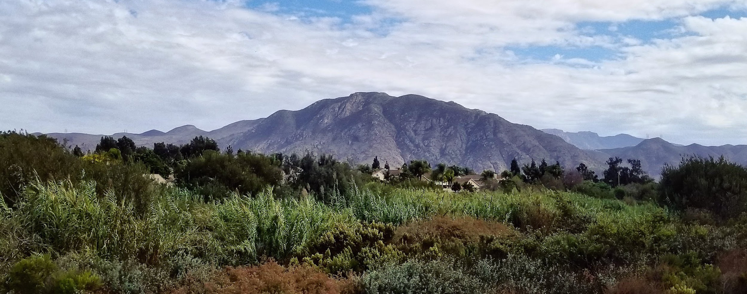
WHAT IS THE CENSUS?
Constitutional right to be counted
Everyone counts! Every resident (not just citizens)

Slide 5
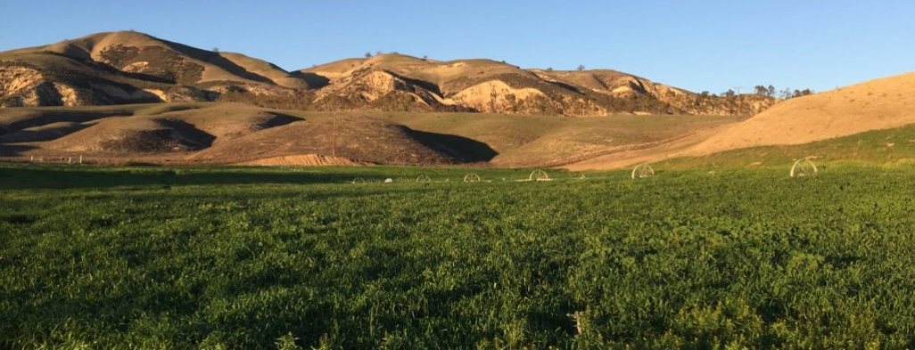
KEY REASONS TO PARTICIPATE:
Funding for our Social Safety Net
Funding for Police Departments
Information about the Community
Determines our Congressional Representation

Slide 6
WHY THE CENSUS MATTERS
The Census determines funding for:
Rural business and industry development loans
Job training and other employment programs
Healthcare for infants and children
Childcare for low-income and working families
Water and waste disposal systems

Slide 7
WHY THE CENSUS MATTERS (CONT’D)
The Census also determines funding for:
Local agencies for food, healthcare, and legal services for senior citizens and individuals with disabilities
Police agencies and community-based entities working to reduce crime
Monitoring and enforcing discrimination laws under the Civil Rights Act
And so much more…

Slide 8
THE MONEY
Of the $675 Billion in Federal Funding allocated nationwide every year based on the 2010 Census:
California received $76.7 billion
Ventura County received $1.7 billion
EVERY YEAR FOR 10 YEARS

Slide 9
STATE & PHILANTHROPIC SUPPORT FOR THE CENSUS
$90 million from the State
$288,754 allocated to Ventura Co.
$412,687 to ACBO
$24 million in philanthropy reported nationally
$9.6 million being committed for California
$5.8 million needed for outreach in Ventura County

Slide 10
BARRIERS TO AN ACCURATE COUNT
Lack of public awareness
Climate of fear
Limited broadband access in some Hard-To-Count (HTC) communities
Limited Federal support and increased reliance on State and philanthropic support
The citizenship question
Misinformation campaigns
Numerous disasters within our community in a relatively short period of time

Slide 11
OUR HARD-TO-COUNT AREAS
https://www.censushardtocountmaps2020.us/

Slide 12
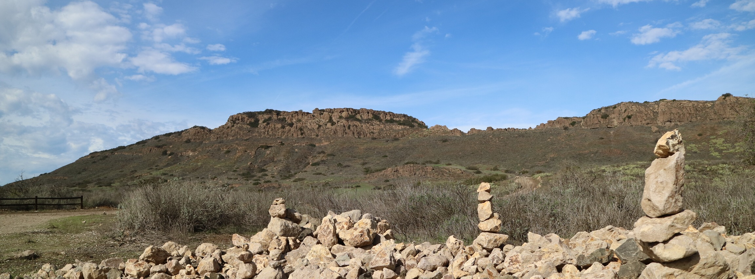
COMPLETE COUNT COMMITTEE OBJECTIVES
Ensure a full, fair, and accurate count Countywide
Develop a Countywide education and outreach plan for HTC communities
Engage in joint fundraising efforts to strengthen outreach activities and avoid duplication of efforts

Slide 13
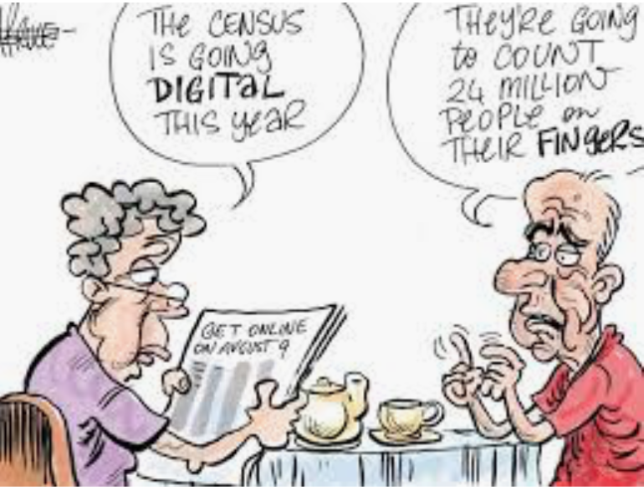
CCC OBJECTIVES (CONT’D)
Build strategic alliances and organizational capacities that could live beyond the Census
Work to solve broadband equity issues
We are a community where everybody counts

Slide 14
SUCCESS FACTORS
Reflect a true snapshot of the whole community
Use technology efficiently
Include diverse perspectives
Select purpose driven and results-oriented subcommittee chairs
Incorporate census awareness activities everywhere
Recruit experienced committee members
Engage many more volunteers

Slide 15
SUBCOMMITTEES
Business and Economic Groups
Budget
Community Based Organizations
Community Events
County Departments
County Government Contact for Funding Requests
Education & Outreach
Faith-based Organizations
Fear Concerns
Health & Human Services
Philanthropic Outreach
PR & Marketing

Slide 16
TIMELINE
Education Phase (2018–2019)
Awareness Phase (April 2019)
Motivation Phase (March 2020)
April 1, 2020—Census Day is here!
Non-Response Follow-Up Phase (May–July 2020)
Celebration (August 2020)

Slide 17
WHAT TO EXPECT
Every household will have the option of responding online, by mail, or by phone.
Nearly every household will receive an invitation to participate in the 2020 Census from either a postal worker or a Census worker.
Timeframe | You’ll receive:
March 12 – 20 | An invitation to respond online to the 2020 Census
March 16 – 24 | A reminder letter
If you haven’t responded yet:
March 26 – April 3 | A reminder postcard
April 8 – 16 | A reminder letter and paper questionnaire
April 20 – 27 | A final reminder postcard before in-person follow-up

Slide 18
KEY RESOURCES
Identifying California’s Hard-to-Count in Census 2020
Program Funding Overview and Pie Chart (PDF)
Community Outreach Funding Allocations and Pie Chart (PDF)
ACBO Regional Funding Allocations (PDF)
County Contract Amounts (PDF)
City Share of HTC (PDF)
Methodology for Calculating City Percentages of County Hardest-to-Count
Tribal Government Funding Availability (PDF)
Census 2020 Regions Map (PDF)
Funding Timeline (PDF)
Census 2020 Funding FAQs

Slide 19
NEXT STEPS FOR INDIVIDUALS
Volunteer to chair a subcommittee
Attend all upcoming meetings
Communicate the importance of the census
Help recruit key community members
Be a MythBuster

Slide 20
NEXT STEPS FOR YOUR CITY
Use all public facing City resources to publicized the Census:
Include information in every City publication
Highlight the Census on your website(s)
Promote participation in the census at Community Council Meetings
Post information on NextDoor and other social media outlets

Slide 21
THANK YOU
www.VenturaCountyCounts.org

